Slide 1
CALLIGRAPHY
AS AN ART FORM

Slide 2
WHAT IS CALLIGRAPHY?
The word calligraphy must be defined. The dictionary states "handwriting or penmanship", or simply "beautiful writing".
The word calligraphy is usually defined by its two Greek roots: kalli meaning beautiful and graphia referring to writing

Slide 3
Writing is the representation of language in a textual medium through the use of a set of signs or symbols (known as a writing system).
Calligraphy is a type of visual art related to writing.
A contemporary definition of calligraphic practice is "the art of giving form to signs in an expressive, harmonious and skillful creative manner"

Slide 4
Calligraphy continues to flourish in the forms of wedding and event invitations, font design/typography, original hand-lettered logo design, religious art, announcements/graphic design/commissioned calligraphic art, cut stone inscriptions and memorial documents.
It is also used for prop and moving images for film and television, testimonials, birth and death
certificates, maps, and other works involving writing.

Slide 5
WEDDING CARDS

Slide 7
WHAT IS TYPOGRAPHY?
Typography (from the Greek words: typos = form and graphe = writing) is the art and technique of arranging type in order to make language visible. The arrangement of type involves the selection of typefaces, point size, line length, leading (line spacing), adjusting the spaces between groups of letters and adjusting the space between pairs of letters.

Slide 8
TYPOGRAPHY

Slide 9
TYPOGRAPHY

Slide 10
HAND LETTERD LOGO DESIGNS

Slide 16
LOGO DESIGNS

Slide 17
LOGO DESIGNS

Slide 18
Inscription- Qutub Minar

Slide 21
MAKLI GRAVEYARD SINDH

Slide 23
HISTORY OF ISLAMIC CALLIGRAPHY
Islamic calligraphy, also known as Arabic calligraphy, is the artistic practice of handwriting, or calligraphy, and by extension, of bookmaking, in the lands sharing a common Islamic cultural heritage. This art form is based on the Arabic script, which for a long time was used by all Muslims in their respective languages. They used it to represent God because they denied representing God with images. Calligraphy is especially revered among Islamic arts since it was the primary means for the preservation of the Qur'an.

Slide 24
Islamic Calligraphy
As it is based on Arabic letters, some call it "Arabic calligraphy".
However the term "Islamic calligraphy" is a more suitable term as it comprises all works of calligraphy by the Muslim calligraphers from Morocco to China.
The history of Islamic calligraphy is incomplete without the name of Ibn e Muqla, the minister and master calligrapher of Abbasid period who introduced the basic rules of Arabic calligraphy and invented six writing scripts.

Slide 25
Six Scripts by Ibn e Muqla

Slide 27
The history of Arabic calligraphy provides information that it was in practice by the end of 7th century by Nabataeans, the ancient Arabic speaking people from North Arabia, who carved rock inscriptions which was already in-practice as bold and irregular forms of writing without following any rules.

Slide 28
Islamic calligraphy excelled due to the forms of Arabic letters, composed of dots, lines and curves. These attributes give the artist a freedom to create.
Calligraphy for Muslims is a visible expression of the highest art of all, the art of the spiritual world.
The holy book of Islam, al-Qur'an, has played an important role in the development and evolution of the Arabic language and Islamic Calligraphy.

Slide 29
VARIOUS STYLES
Various styles of Arabic Calligraphy have been identified over time.
Kufic is the earliest known form of calligraphic script. It's characterized by straight lines and angles
It was in this script that the first copies of the Qur'an were written.

Slide 30
FOLIO FROM QURAN 8TH TO 9TH CENTURY

Slide 31
FAMOUS BLUE QURAN MANUSCRIPT

Slide 32
QURAN FOLIO 11TH CENTURY

Slide 33
This style was also used in architecture. The following images are from the Sultan Hassan Mosque.

Slide 35
Kufic style was also used to decorate objects.

Slide 37
An example of contemporary form of Kufic Script

Slide 38
NASKH STYLE
A more cursive form of script, known as Naskh, developed over time and began appearing around 900.
Naskh, which means "copying," was developed in the 10th century, and refined into a fine art form in Turkey in the 16th century.
It is a small script whose lines are thin and letter shapes are round.
The following are different examples of Naskh in various Qurans.

Slide 39
NASHK SCRIPT

Slide 40
NASHK SCRIPT QURANIC VERSES

Slide 41
AL-FATIHAH (NASHK SCRIPT)

Slide 42
THE THULUTH SCRIPT
Thuluth was the medieval Islamic style of handwritten alphabet. Thuluth (Arabic: "one-third") is written on the principle that one-third of each letter slopes.
It is a large and elegant, cursive script, used in medieval times on mosque decorations.
It took on some of the functions of the early Kufic script; it was used to write surah headings, religious inscriptions, and princely titles and epigraphs. It was also used for many of the large copies of the Quran produced from the 13th century.

Slide 43
THULUTH SCRPIT

Slide 46
The Ta'liq and Nasta'liq / Farsi Scripts
Ta'liq is a cursive style of lettering developed in Iran in the 10th century.
The rounded forms and exaggerated horizontal strokes that characterize the Ta'liq letters were derived primarily from the Riqa' script.

Slide 47
Nasta'liq Script
Nasta'liq was the predominant style of Persian calligraphy during the 15th and 16th centuries. The inventor was Mir 'Ali of Tabriz, the most famous calligrapher of the Timurid period (1402-1502).
A cursive script, Nasta'liq was a combination of the Naskh and Ta'liq styles, featuring elongated horizontal strokes and exaggerated rounded forms. The diacritical marks were casually placed, and the lines were flowing rather than straight.
Nasta'liq was frequently incorporated into the paintings of the early Safavid period (16th century) and is traditionally considered to be the most elegant of the Persian scripts.

Slide 48
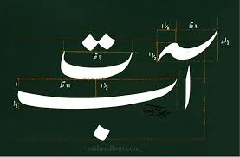
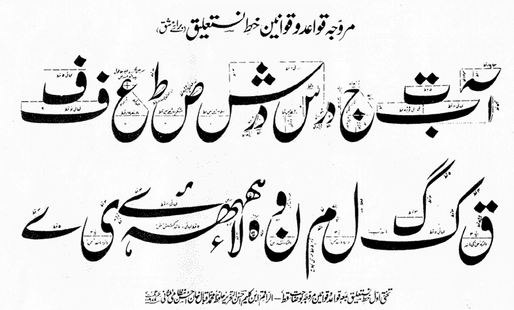
Nasta'liq Script

Slide 49
The Riq'a Script
Riq'a, the simpler style of everyday writing is very economical and easy to write. It is popular for writing both Turkish and Arabic.

Slide 50
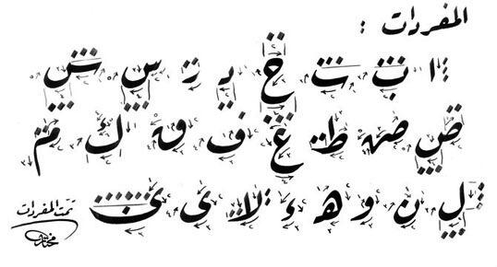
The Riqa Script

Slide 51
THE DIWANI SCRPIT
Diwani script is a cursive style of Arabic calligraphy developed during the reign of the early Ottoman Turks (16th-early 17th century).
It was invented by Housam Roumi and reached its height of popularity under Süleyman I the Magnificent (1520-66).
As decorative as it was communicative, Diwani was distinguished by the complexity of the line within the letter and the close juxtaposition of the letters within the word.

Slide 52
THE DIWANI SCRIPT

Slide 53
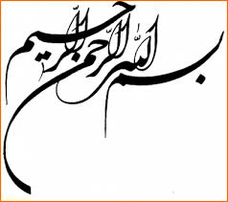
Shikasta Script

Slide 54
Persian Calligraphy
Persian calligraphy is the calligraphy of Persian writing system. The history of calligraphy in Persia dates back to the pre-Islam era.
It is believed that ancient Persian script was invented by about 600-500 BC to provide monument inscriptions for the Achaemenid kings. These scripts consisted of horizontal, vertical, and diagonal nail-shape letters and that is the reason in Persian it is called "Script of Nails/Cuneiform Script" (Khat-e-Mikhi). Centuries later, other scripts such as "Pahlavi" and "Avestan" scripts were used in ancient Persia.

Slide 56
PICTOGRAM
A pictogram, also called a pictogramme or pictograph, is an ideogram that conveys its meaning through its pictorial resemblance to a physical object. Pictographs are often used in writing and graphic systems in which the characters are to a considerable extent pictorial in appearance.
Pictography is a form of writing which uses representational, pictorial drawings. It is a basis of cuneiform and, to some extent, hieroglyphic writing, which also uses drawings as phonetic letters or determinative rhymes.

Slide 57
What is ideogram?
An ideogram or ideograph (from Greek ἰδέα idea "idea" + γράφω grafo "to write") is a graphic symbol that represents an idea or concept.

Slide 58
IDEOGRAMS

Slide 59
POINTING FINGER IDEOGRAM

Slide 60
CUNEIFORM SCRIPT
Cuneiform script is one of the earliest known systems of writing.
Being a character or characters formed by the arrangement of small wedge-shaped elements and used in ancient Sumerian, Akkadian, Assyrian, Babylonian, and Persian writing.

Slide 61
CUNEIFORM ALPHABETS

Slide 62
CUNEIFORM NUMERAL

Slide 63
CUNEIFORM SCRIPT ON STONE

Slide 64
AKKADIAN CUNEIFORM SCRIPT

Slide 65
Hieroglyphic writing
The Egyptian writing called hieroglyphics used pictures to represent different objects, actions, sound or ideas.
It was a formal writing system used by the ancient Egyptians that combined logographic and alphabetic elements.
There were more than 700 hieroglyphs. Some pictures stood for whole words.

Slide 66
HIEROGLYPHIC TABLE

Slide 67
HIEROGLYPHIC WRITING

Slide 72
Hieroglyphs is made from two Greek words:
hieros meaning holy
glyphe meaning writing
So hieroglyph means holy writing.

Slide 73
How do we know how to read hieroglyphics ?
This writing was uncovered by the Rosetta Stone. Hieroglyphics uses small pictures which represent the sound of the object or an idea associated with the object

Slide 74
ROSETTA STONE

Slide 76
Material
What did Ancient Egyptians write on?
Hieroglyphs were written on papyrus reed, which is a water or marsh plant, with tall straight hollow stems. The reeds were flattened, dried, and stuck together to make pages.
The Egyptians also carved hieroglyphs onto stone and painted them on the walls of the tombs.

Slide 77
What did Ancient Egyptians use to write with?
Egyptian writing was done with pen and ink on fine paper (papyrus).
Egyptian "pens" were thin, sharp reeds, which they would dip in ink to write with.
The ink and paint came from plants which they crushed and mixed with water.

Slide 78
Where did the Ancient Egyptians use writing?
They used writing in a variety of places including scribe schools, on tomb walls, in fields, in temples, at war and in government documents.

Slide 79
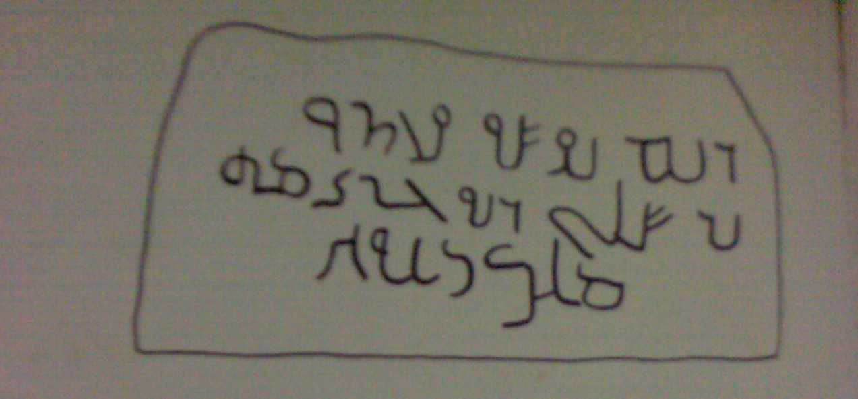
Stone Tablet Inscription, Jordan

Slide 80
CHARACTERISTICS
Contemporary artists in the Islamic world draw on the heritage of calligraphy to use calligraphic inscriptions or abstractions in their work.
The holy book of Islam, the Qur'an, has played an important role in the development and evolution of the Arabic language & calligraphy.
Proverbs and complete passages from the Qur'an are still active sources for Islamic calligraphy.

Slide 81
In Western art calligraphy is a minor art form, mostly confined to books and the occasional decorative function. But in Islamic art, the practice of beautiful writing is much more evident.

Slide 86
BY GOLNAZ FATHI

Slide 87
BY GOLNAZ FATHI

Slide 88
BY GOLNAZ FATHI

Slide 89
BY GOLNAZ FATHI

Slide 90
BY GOLNAZ FATHI

Slide 92
BY GOLNAZ FATHI

Slide 94
SAT BHAYYAN SHRINE, SINDH

Slide 95
BY GUNTER LUDWIG

Slide 96
BY GUNTER LUDWIG

Slide 98
BY SADEQUAIN

Slide 100
BY ARIF KHAN

Slide 105
By ali azmat

Slide 106
By Shakir Ali

Slide 107
By Gulgee

Slide 108
By Gulgee (Nukta)

Slide 109
By Gulgee

